Slide 1

Project on:
Hospital Patient Lifecycle & Payer Coverage Optimization Study
Name:
Parmar Arpitaba manishbhai
summary:
To optimize hospital performance, this project engineers
a robust pipeline to clean clinical records, model relational
data, and analyze patient readmission and cost metrics.

Slide 2
Clinical Intelligence & Cost Pipeline
Technical Architecture & Tooling
Python (Pandas & NumPy):
Automated the ETL (Extract, Transform, Load) process by standardizing date-time formats, handling missing clinical codes, and cleaning string data for over six healthcare datasets.
Engineered a robust relational database schema, implementing primary/foreign key constraints and utilizing advanced window functions to calculate complex KPIs like 30-day patient readmission rates.
PostgreSQL:
Power BI:
Developed an interactive executive dashboard to visualize encounter trends, payer coverage gaps, and departmental cost distributions for data-driven hospital administration.

Slide 3
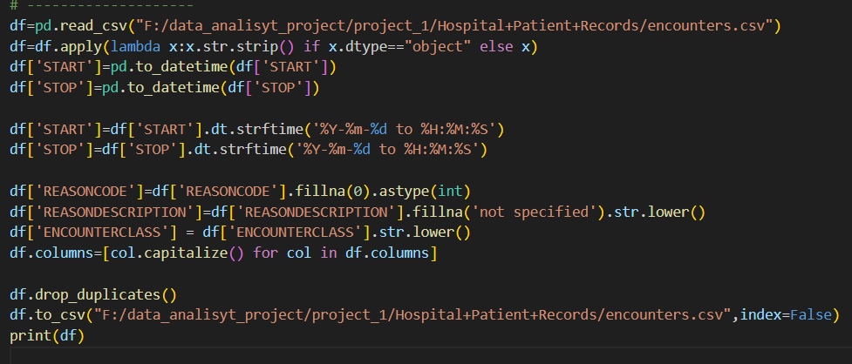
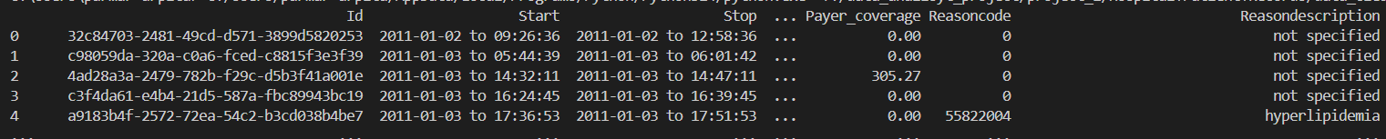
Key Data Transformations: Encounter Dataset
Temporal Normalization:
Converted START and STOP strings into standardized datetime objects and reformatted them into a unified YYYY-MM-DD to HH:M:S string for consistent reporting.
Integer Casting & Null Handling:
Addressed missing REASONCODE values by filling
nulls with 0 and casting the column to an Integer type to ensure compatibility with SQL numeric types.
Text Standardization:
Applied .str.lower() to REASONDESCRIPTION and ENCOUNTERCLASS to eliminate case-sensitivity issues during SQL GROUP BY operations.
Schema Alignment:
Dynamically capitalized all column headers to match the target PostgreSQL table schema, ensuring a seamless bulk-insert process.
Data Integrity:
Implemented a .drop_duplicates() check to remove redundant records and filled missing REASONDESCRIPTION entries with 'not specified' to maintain descriptive data quality

Slide 4



SCOPE AND GOALS
Project Scale & Scope:
Unified 6 Critical Datasets:
Standardized Pipeline
Developed automated cleaning scripts for Patients, Encounters, Procedures, Organizations, Payers, and Data Dictionary.
Applied universal logic across all sources to ensure 100% schema compatibility for PostgreSQL ingestion..

Slide 5
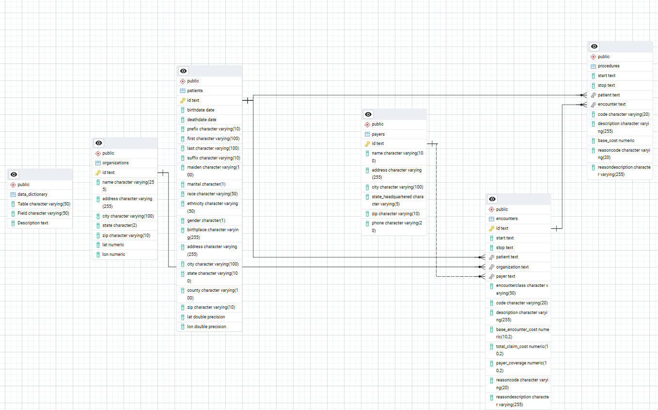
📊 E-R DIAGRAM
Dr. Connor

Slide 6
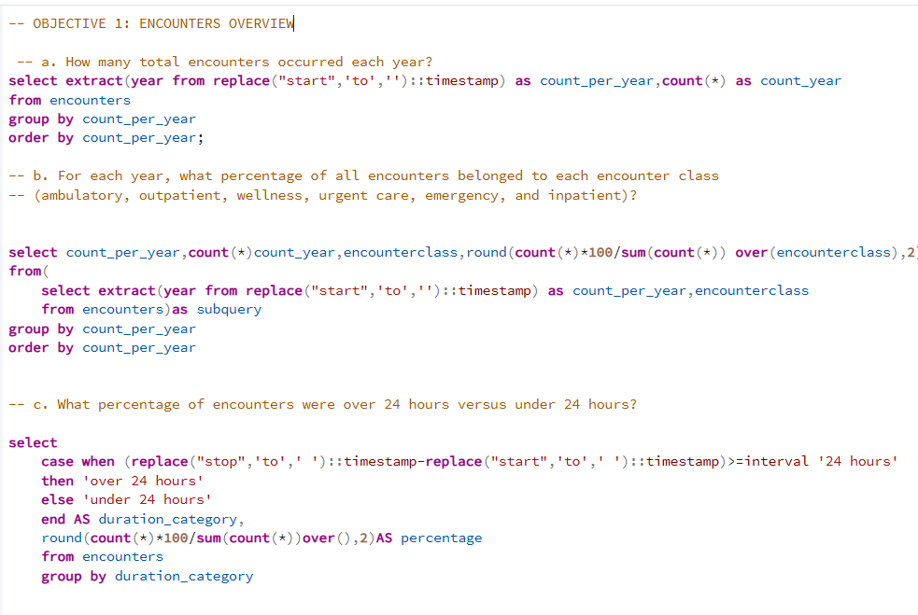
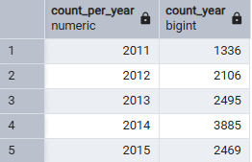
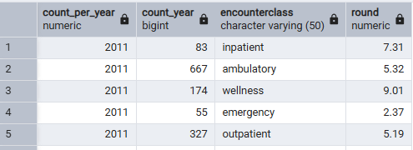
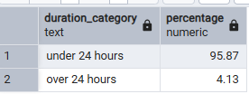
Encounter Trends (Objective 1)
Output of a:
Output of b:
Access to Healthcare Services
Healthy Lifestyle Promotion
Output of c:

Slide 7
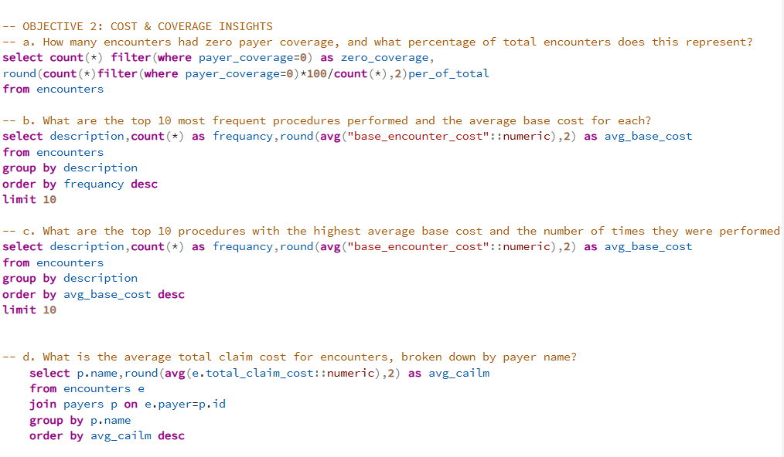
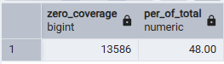
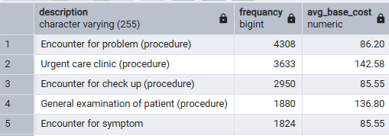
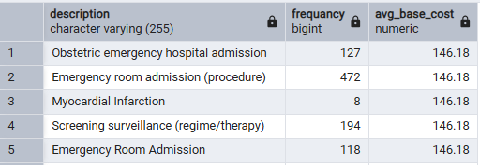
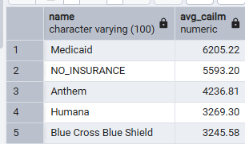

Cost & Coverage Insights (Objective 2)
Output of a:
Output of b:
Output of c:
Output of d:

Slide 8
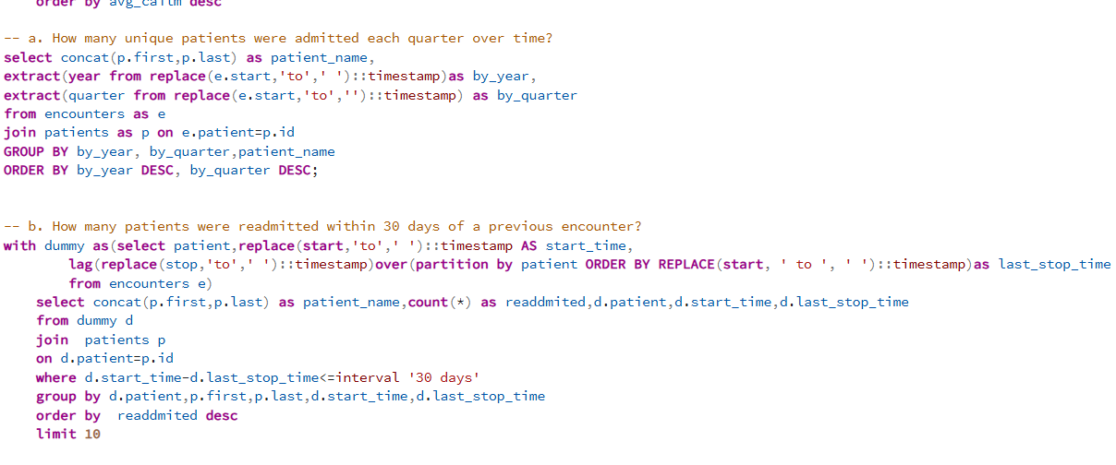
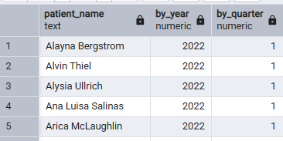
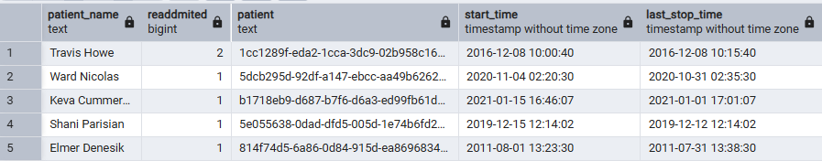
Patient Outcomes & Readmissions
Output of a:
Output of b:

Slide 9
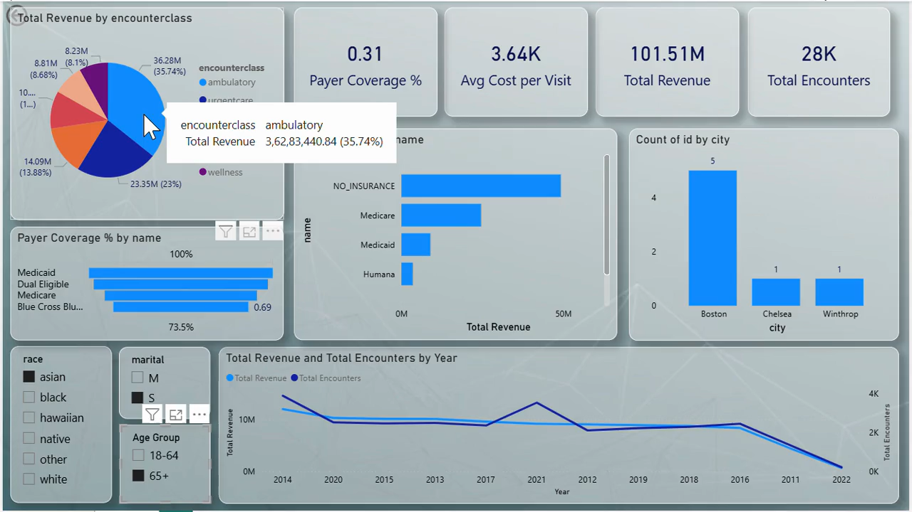
Hospital Patient Lifecycle & Payer Coverage Optimization Dashboard
.

Slide 10




Patient Outcomes & Readmissions
End-to-End Data Engineering: Successfully architected a complete pipeline that automates the transformation of fragmented clinical CSVs into a high-performance PostgreSQL relational database.
Operational Quality Metrics: Developed a sophisticated tracking system for 30-day patient readmissions using SQL window functions, providing hospital leadership with a direct measure of care quality and discharge effectiveness.
Financial Risk Identification: Delivered deep-dive analytics into payer coverage gaps and procedure costs, uncovering trends that allow for better revenue cycle management and insurance contract optimization.
Scalable Business Intelligence: Built a dynamic Power BI environment that replaces static reporting with interactive, real-time insights, enabling data-driven decision-making across clinical and administrative departments.
End-to-End Data Engineering
Operational Quality Metrics:
Financial Risk Identification:
Scalable Business Intelligence:

Slide 11




Thank you
Get In Touch With Us
https://github.com/arpitaparmar1
arpitaparmar548@gmai.com
https://www.linkedin.com/in/arpita-parmar-b70476348/
+919033344102

